Slide 1

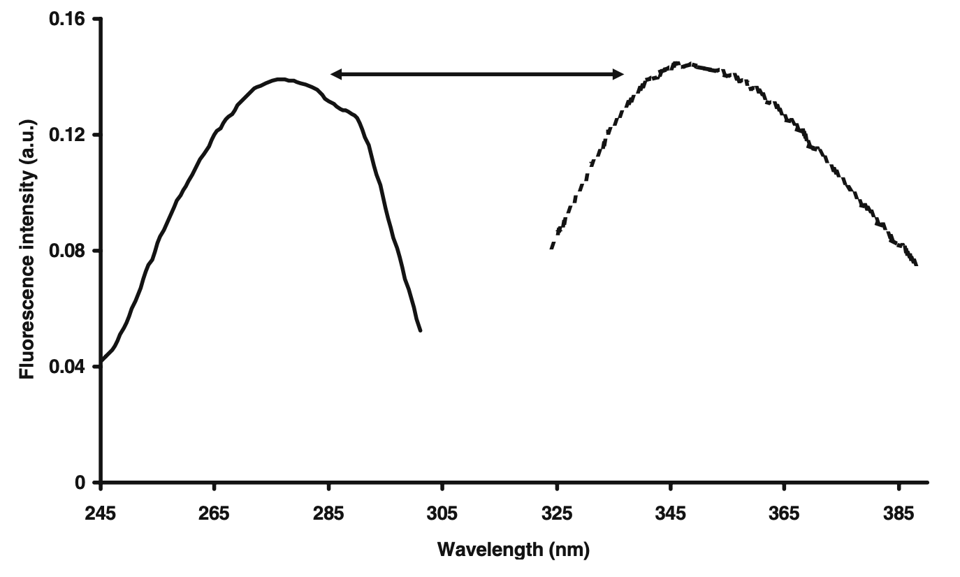
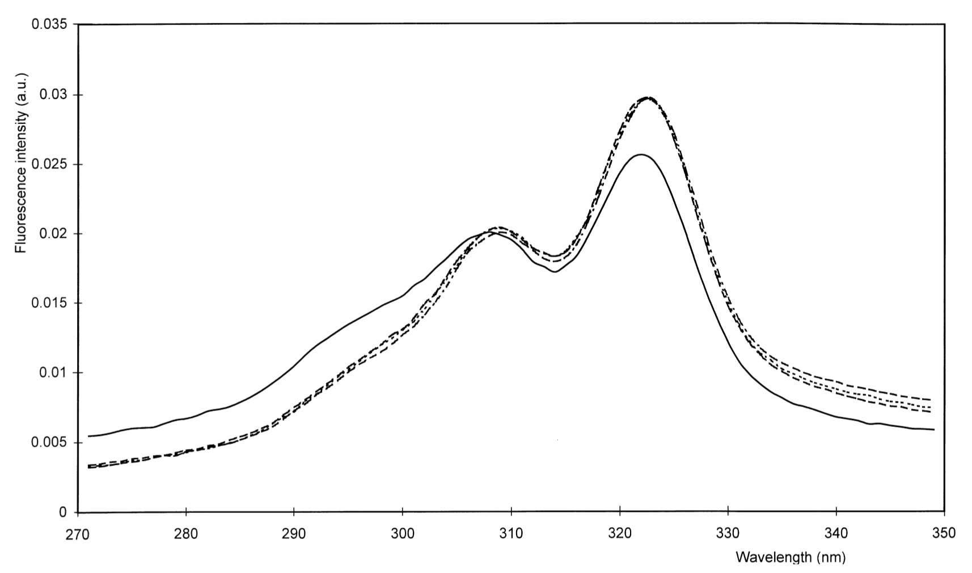
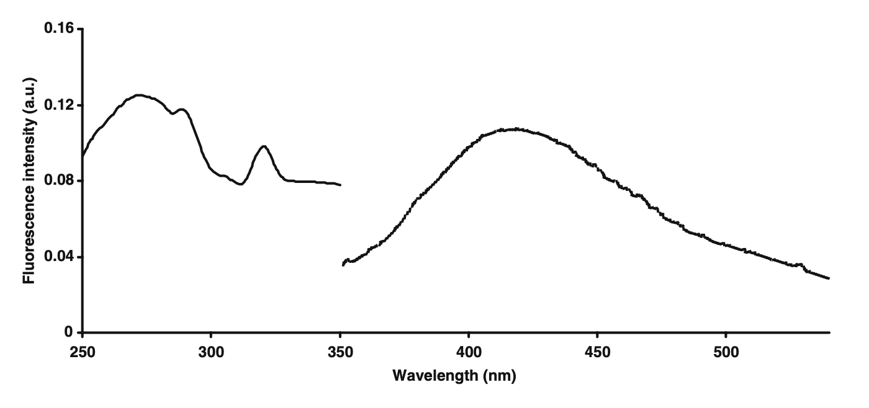
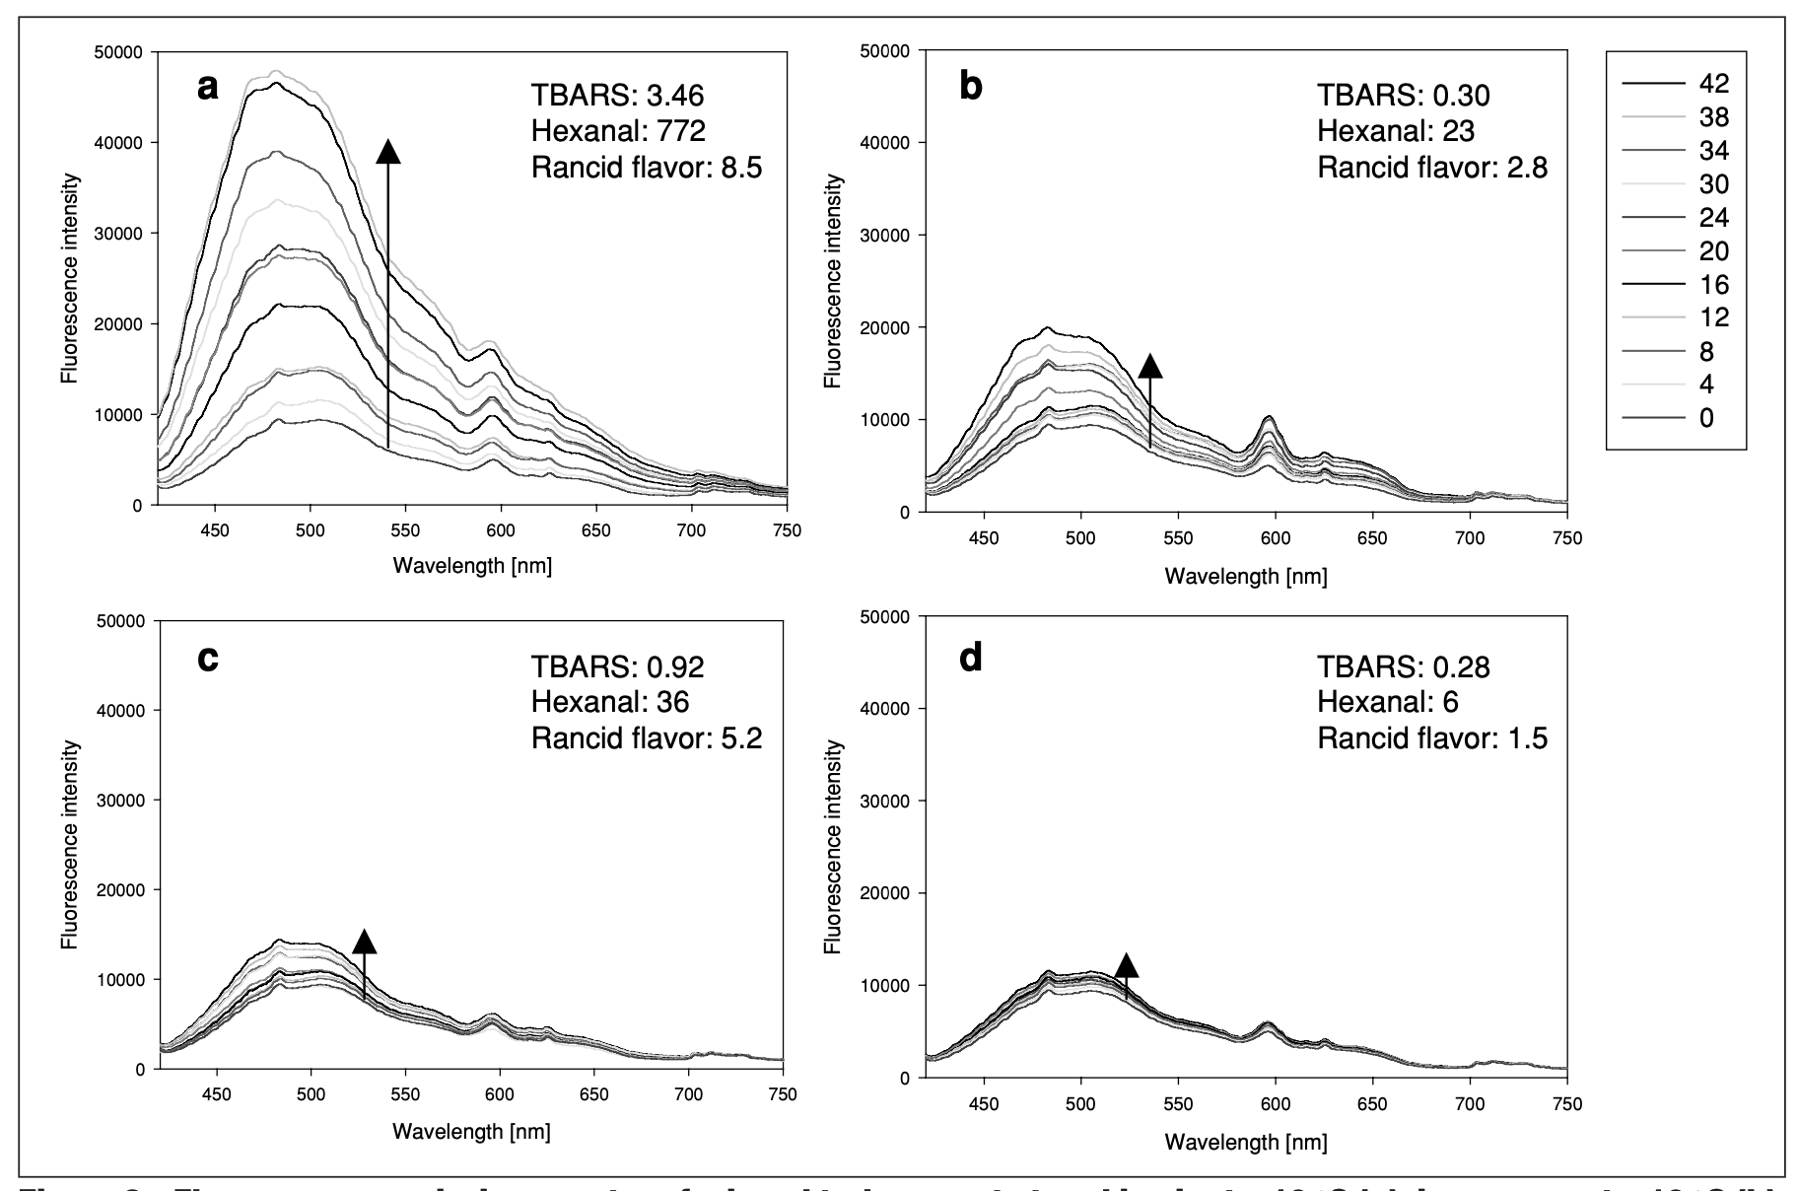
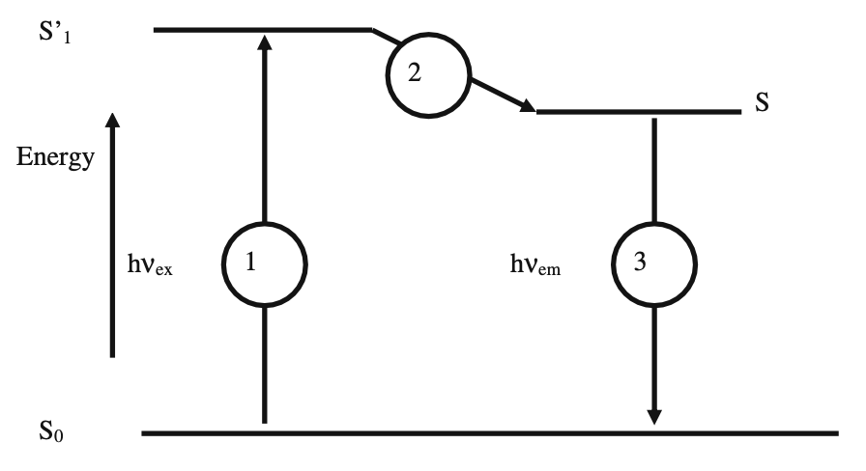
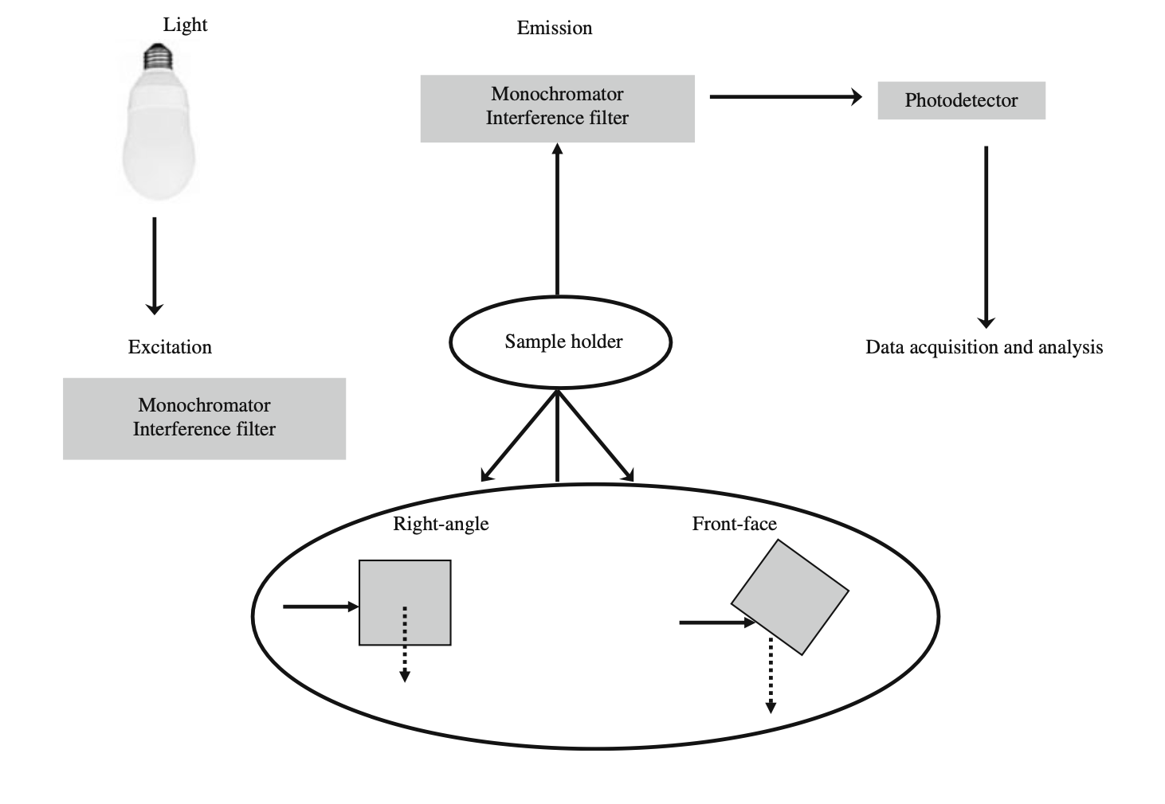
Fluorescence Spectroscopy Measurement for
Quality Assessment of Food Systems
Group 17 WANG Jing LIU Ziqi JIN Cancan FENG Zixia
Abstract
Instrumentation
Data Analysis
From the present review, it was shown that fluorescence spectroscopy is able to determine several properties without the use of chemical reagents. This is due to the use of chemometric tools (descriptive and predictive methods). Our study focuses on the use of fluorescence spectroscopy for the determination of the quality of diary and meat products.
PCA: Principal Component Analysis
CCSWA: Common Component and Specific Weights Analysis
PLS: Partial Least Squares Regression
FDA: Factorial Discriminant Analysis
PARAFAC: Parallel Factor Analysis
Applications
Dairy Products
Introduction
Fig.2
The difference between the excitation and emission wavelengths: marking the difference between the excitation and emission spectrum of tryptophan fluorescence spectra scanned on milk submitted
The mirror image: The emission spectrum for a given fluorophore is a mirror image of the excitation spectrum
Public interest in food quality and production has increased in recent decades
The demand for high quality and safety in food production obviously calls for high standards for quality and process control.
Fluorescence spectroscopy is an analytical technique whose theory and methodology have been extensively exploited for studies of molecular structure and function in the discipline of chemistry and biochemistry
FFFS: Front-face Fluorescence Spectroscopy
SFS: Synchronous Fluorescence Spectroscopy
Fig.5 FFFS of cheeses recorded at 4 times during ripening:
1 day (*)
21 days (} })
51 days (- - -)
81 days (} - } -)
A max at 322 nm and two shoulders at 305 and 295 nm
The shape of the spectra changed with time.
The changes of fat structure tally with the conclusions derived from infrared data.
Fig.3
Meat and Meat Products
The fluorescence of vitamin A, as seen in Fig. 3, with 3 absorption peaks and only 1 emission peak.
Fluorescence Spectroscopy
Fig.1 the basic principle in fluorescence spectroscopy
Fig.6 Fluorescence emission spectra of turkey meat stored
in air at −10 ◦C (a)
in vacuum at −10 ◦C (b)
in air at −20 ◦C (c)
in vacuum at −20 ◦C (d)
S0 -> S′1: light is absorbed by the molecule, which is transferred to an electronically excited state
S′1 -> S: A vibrational relaxation or internal conversion
Fig.4
The excitation light travels into the sample from one side
The detector is positioned at right angles to the center of the sample.
FFFS: measure more turbid or opaque samples, since the signal becomes more independent
The sample is placed with its surface at an angle of 30°/60° to the light source and the detector.
A significant increase in fluorescence intensity for all 4 storage conditions
The fluorescence intensities increased most for stored in air at −10 ◦C, followed by sin vacuum at −10 ◦C, in air at −20 ◦C, and in vacuum at −20 ◦ C.
More fluorescent compounds were formed in the turkey meat stored in vacuum at −10◦C compared to meat stored in air at −20 ◦C.
S′1 -> S0: the electron returns to its more stable ground state S0, emitting light at a wavelength according to the difference in energy between the two electronic states.
Fig.1 Fig.2. Fig.3 Fig.4 Karoui, R., & Blecker, C. (2011). Fluorescence Spectroscopy Measurement for Quality Assessment of Food Systems—a Review. Food Bioprocess Technol, 4, 364–386. https://doi.org/10.1007/s11947-010-0370-0.
Fig.5 Dufour, E., Mazerolles, G., Devaux, M.F., Duboz, G., Duployer, M.H., & Mouhous Riou, N. (2000). Phase transition of triglycerides during semi-hard cheese ripening. International Dairy Journal, 10, 81-93.
Fig.6 Veberg, A., Olsen, E., Vogt, G., Mielnik, M., Nilsen, A. N., & Wold, J. P. (2006). Front Face Fluorescence Spectroscopy—A Rapid Method to Detect Early Lipid Oxidation in Freeze Stored Minced Turkey Meat. Journal of Food Science, 71(3), C155-C162. https://doi.org/10.1111/j.1750-3841.2006.00019.x

